Slide 1
A Systematic Literature Review on Distributed Machine Learning in Edge Computing
Submitted by: Rifat Alam Pomil
ID: 23266028
Department: CSE
Course ID: CSE707
Course Name: Distributed Computing System
Submitted to:
Annajiat Alim Rasel
Senior Lecturer, BRAC University

Slide 2
Outline
Introduction
Motivation
Contribution
Methodology
Conclusion
First Limitation
Second Limitation
Synthesis

Slide 3
Introduction
This paper explores distributed edge intelligence, which allows ML/DL algorithms to run closer to data sources.
The authors investigate the challenges and adaptations needed for edge devices, covering caching, training, inference, and offloading processes, and discuss their benefits and drawbacks.

Slide 4
Motivation
Conducting a literature review on distributed machine learning in edge computing.
Focus on implementing machine learning and deep learning on edge devices.
Addressing limitations of edge devices compared to traditional cloud devices.
Aim to investigate challenges and adaptations for resource-constrained edge devices.
Hypothesis: Edge intelligence can offer lower latency, improved security, and enhanced privacy.

Slide 5
Contribution
Extensive review of distributed machine learning in edge computing.
Exploration of edge caching, training, inference, and offloading techniques.
Key contributions: Reduced latency, improved security, enhanced privacy.
Presentation of reference frameworks for future edge intelligence research.

Slide 6
Methodology
Systematic review of literature on distributed machine learning in edge computing.
Analysis of edge caching, training, inference, and offloading techniques.
Critical examination of these approaches and their application implications.

Slide 7
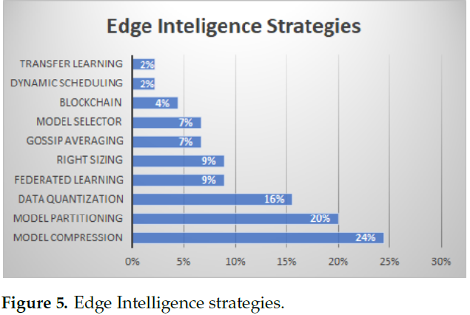
Edge Intelligence Strategies

Slide 8
Conclusion
Emphasis on edge intelligence's importance for overcoming edge device limitations.
Benefits: Reduced latency, improved security, enhanced privacy.
Valuable resource for future research in the field.

Slide 9
First Limitation
Focus on Existing Approaches:
The paper centers on existing techniques and frameworks without proposing novel solutions.
Lack of specific addressal of challenges in implementing edge intelligence is noted.
Comprehensive Overview:
While offering a comprehensive overview, the paper could benefit from more in-depth analysis.
Practical case studies could enhance the depth of understanding.

Slide 10
Second Limitation
Limited Exploration of Real-World Applications:
The paper exhibits a constraint in exploring real-world applications and use cases of edge intelligence.
Providing more examples for specific industries and scenarios could enrich its practical relevance.

Slide 11
Synthesis
Foundation for potential applications and future research in edge intelligence.
Revolutionizing industries like IoT, healthcare, energy management, and transport systems.
Future research scopes: Innovative techniques, practical case studies, new applications for edge intelligence.

